Slide 1
Meskwaki Nation Department of Natural Resources
Natural Resource Management of Tribal Lands

Slide 2
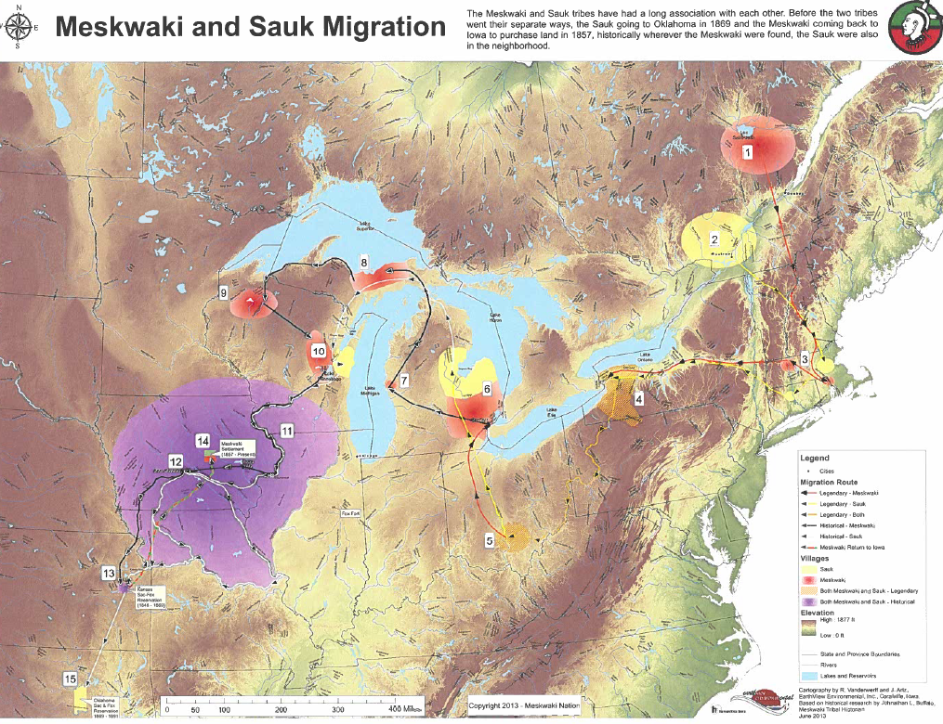

Slide 3
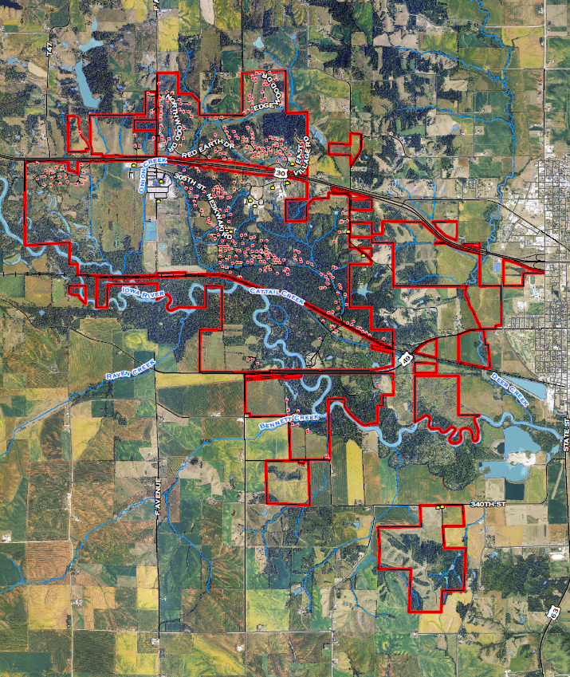

Slide 4
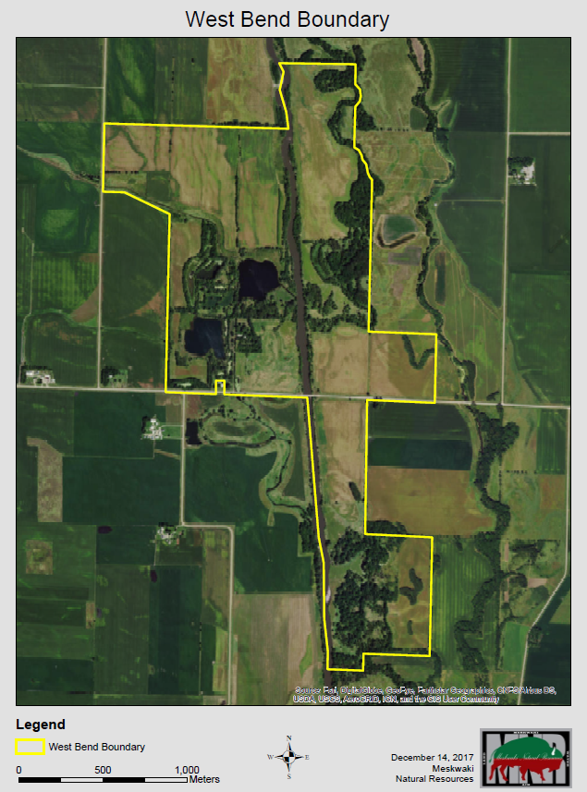

Slide 5
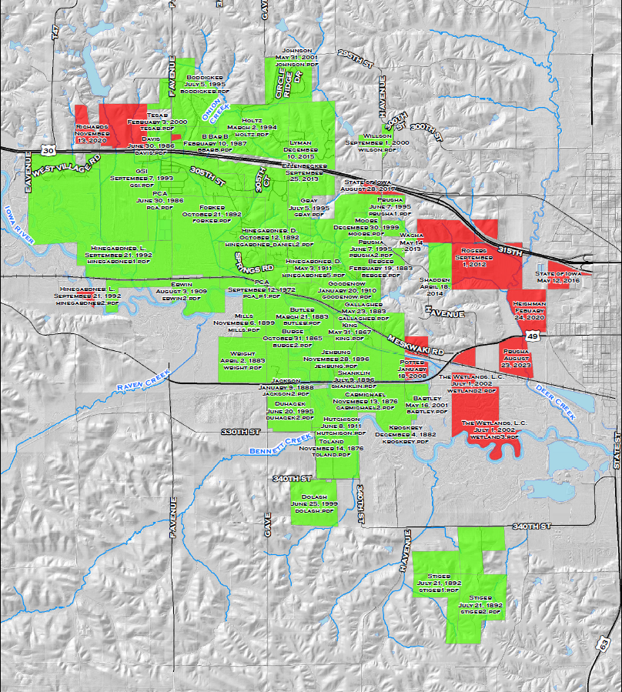

Slide 6
